Slide 2
Disclaimer
Document Name:
Data Classification: INTERNAL
Disclaimer
The contents of this document are property of Softtek, and are classified as Confidential. Any reproduction in whole or in part is strictly prohibited without the written permission of Softtek.
This document is subject to change. Comments, corrections or questions should be directed to the author.
Audience/Viewership | Purpose
Revision Chart
The following chart list the revisions made to this document. Use this to describe the changes and additions each time this document is re-published. The description should be detailed as possible and include the names of the reviewers who request the changes.
Version No. | Version Date | Types of Changes | Owner/Author | Date of Review/Expiration

Slide 3
Knife Bootstrap Oracle DB Handling

Slide 4
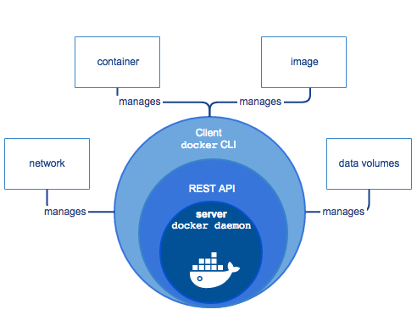
What is docker?

Slide 5
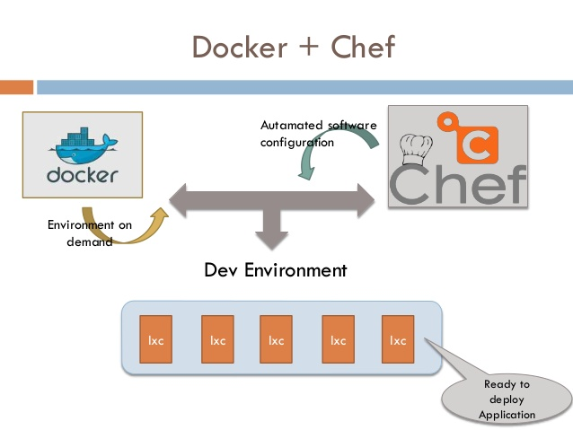

Slide 6
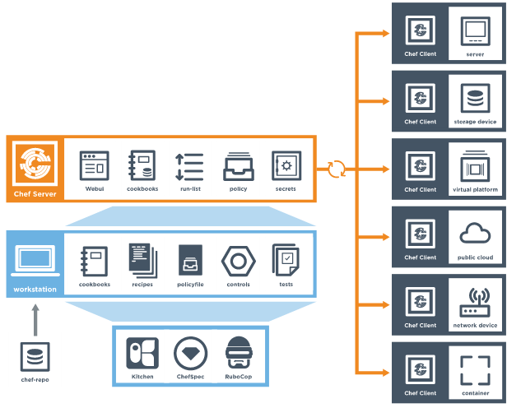
Chef components review
Managed Nodes

Slide 7
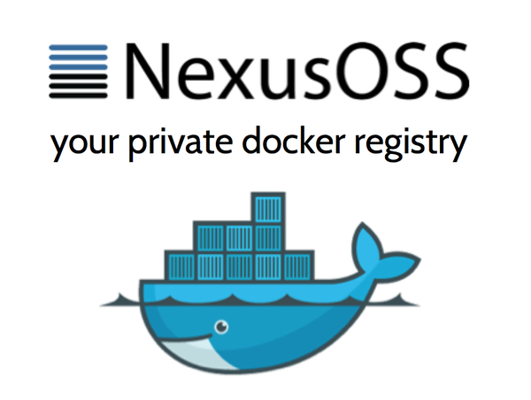
Nexus
Nexus is a repository manager, and acts as a staging repository which "intercepts" artifacts uploaded by mvn deploy.
Thus artifacts can be safely deployed to Nexus as part of voting on a release. The vote takes place on the staged artifacts. If the vote succeeds, the artifacts can be promoted to the live repository. If it fails, the artifacts can be deleted, and the process can restart.
It also allows redundant files (such as .asc.md5 and .asc.sha1 hashes) to be deleted before deployment.

Slide 8
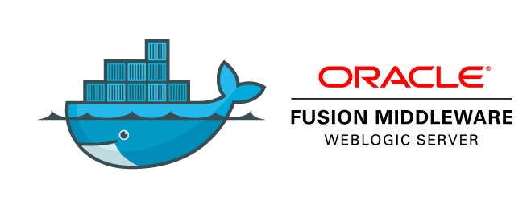
Oracle

Slide 9
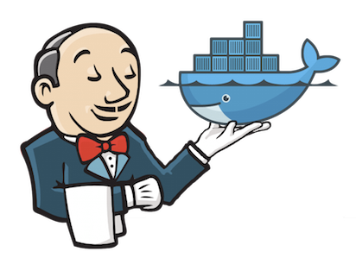
Jenkins
Jenkins is an award-winning, cross-platform, continuous integration and continuous delivery application that increases your productivity.
Use Jenkins to build and test your software projects continuously making it easier for developers to integrate changes to the project, and making it easier for users to obtain a fresh build.
It also allows you to continuously deliver your software by providing powerful ways to define your build pipelines and integrating with a large number of testing and deployment technologies.

Slide 10
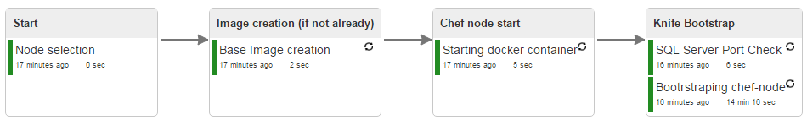
Demo bootstrap pipeline
Node selection: Works as pipeline starter by selecting the number id for the chef-node to deploy.
Base Image creation: This job pulls a docker pre-built image which contains an OS Ubuntu:16.04.
Starting docker container: Starts docker container with the required parameters (hostname and links to sql-server and chef-server respectively).
SQL Server Port Check: Reviews ports opened in sql-server and checks contextual functionality of the database.

Slide 11
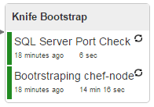
Bootstraping chef-node
Bootstraping chef-node: Sends a signal through knife to the recently created chef-node, a bootstrap which would connect the node with the chef server and allowing this last to recognize as node/client.
Default: Creates the required environment for Oracle SQL-plus client to be installed as expected, upgrades Ubuntu to the latest version and configures OS to embrace the client with no errors.
Table_create: Creates a brand new table within the database previously stated.
Table_insertion: Inserts dummy values into the previously created table in step above.

Slide 12
Workstation demo

